Slide 1
Data ANALYSIS project
By
Onyejiuwa Joseph

Slide 2
AIM/OBJECTIVES
AIM
This project aims to create an interactive visualization using Power BI for a given data set that can be understood at first glance and used to solve challenges surrounding the given data set.
Objectives
To achieve the above-stated aim the following objectives are paramount;
Data cleaning
Creating data model and table connections
Creating interactive data visualizations
Data interpretation

Slide 3
DATA SOURCE AND DESCRIPTION
Data Title: Nigeria 2017 Crime Data
Source: Kaggle (https://www.kaggle.com/datasets/ambolatunji/nigeria-2017-crime-data)
Retrieved from Nigeria Bureau of Statistics (NBS)
Description: Some specific crimes are rampant in some states in Nigeria so before you visit any state as a stranger it will be wise to know the common crimes committed in that state. It is categorically divided into offences against lawful authority, offences against persons and offences against property. The data is retrieved from the Nigeria Bureau of Statistics

Slide 4
DATA-CLEANING
Some of the data-cleaning measures taken include but are not limited to the following;
Text formatting
Alphabetical sorting
Erase some unnecessary data
Addition of columns
Creation of tables
Data cleaning was done with MS Excel and powerquery editor.

Slide 5
Data MODEL/TABLE CONNECTIONS
To create connections between the tables, a common column needs to be created that serves as the connection point. In this case, the state column connected all the tables.

Slide 6
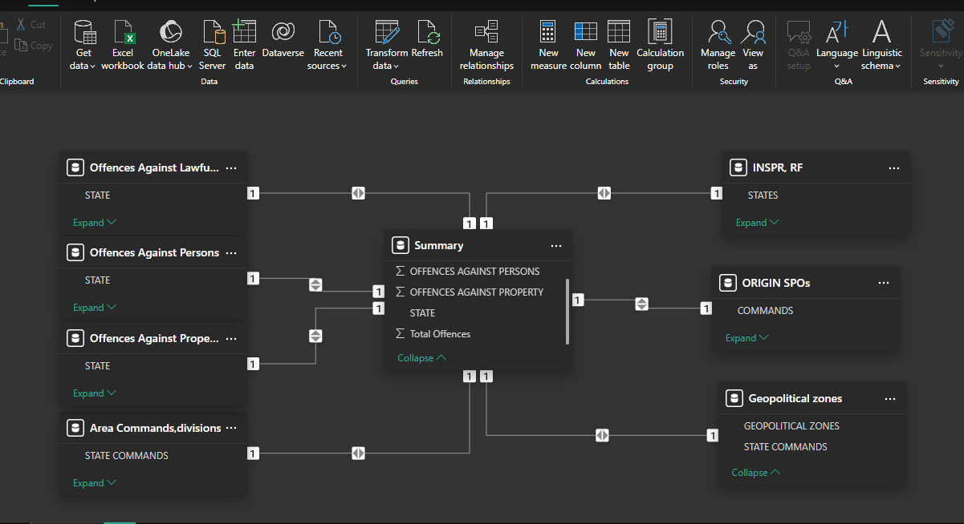
MODEL VIEW/ TABLE CONNECTIONS

Slide 7
DATA VISUALIZATIONS
The following visualizations were created based on the data available;
Total Offences
Offences against persons
Offences against lawful authority
Offences against property
Offences against persons, lawful authority, and persons by state
Total offences and officers by state
Total outposts by state
Total offences by geopolitical zones

Slide 8
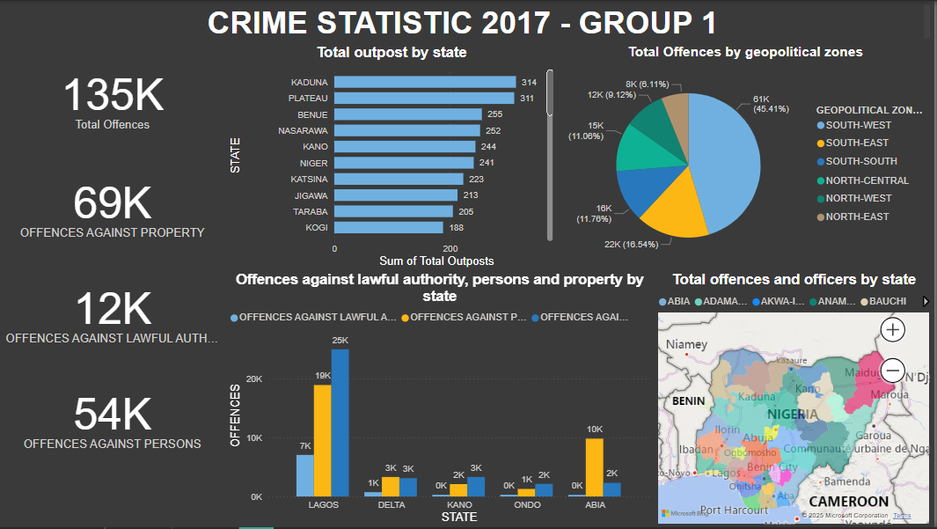
PROJECT DASHBOARD

Slide 9

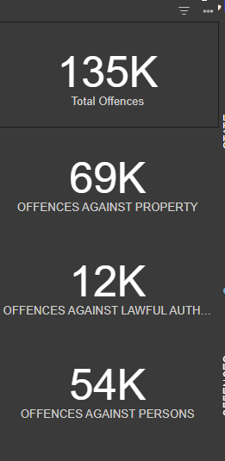
A cumulative of 69,000 offenses against property, 12,000 offenses against lawful authority, and 54,000 offenses against people were committed constituting a total of approximately 135,000 offenses across the country

Slide 10

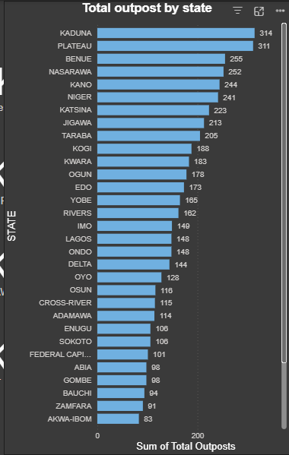
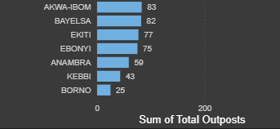
Kaduna state records the highest total police outposts (314).
Interestingly, Borno state in the northeastern region with significantly high terrorist operations records 25 police outposts the lowest sum among other states.

Slide 11
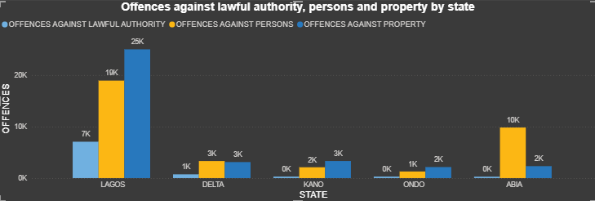
Compared to other states, Lagos state records the highest count of offenses in all ramifications(51,000) accounting for about 40% of the total crimes across the country.
Following Lagos is Abia State. Having a cumulative of about 12,000 offenses, although the majority of offenses were committed against persons, the count of other crimes is significantly low.

Slide 12
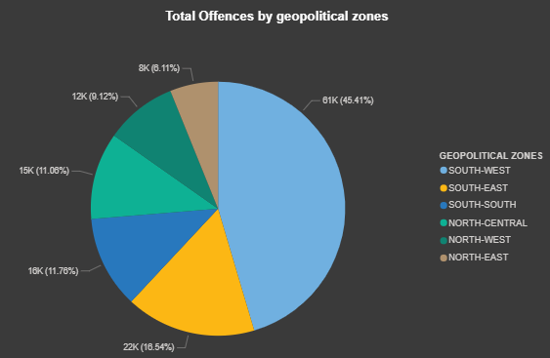
The southwest region has the highest count of offenses among other geopolitical zones while the northeast region records the lowest count of offenses.

Slide 13
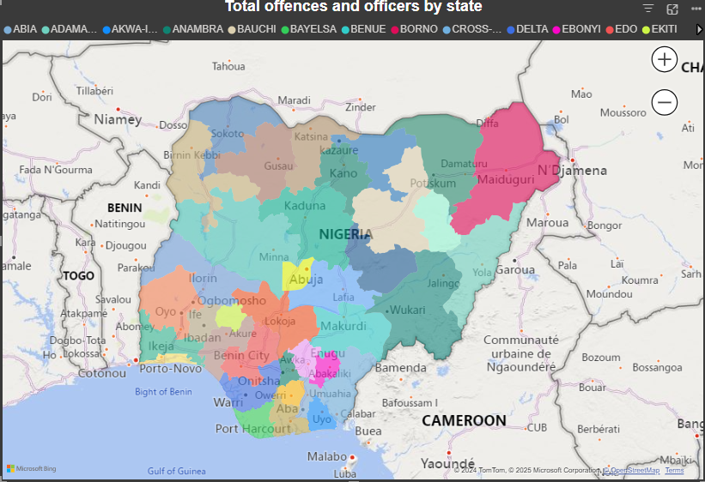
An interactive map showing the distribution of police officers (junior & senior officers) and total offenses by state.

Slide 14
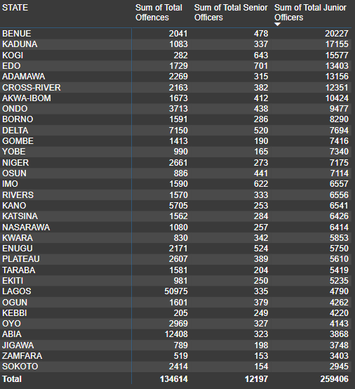
Across all the states, Benue state records the highest number of junior officers on whose shoulders lies the bulk of curbing crimes and offenses.
Interestingly, Lagos state which holds the record for the highest count of offenses ranks average in number of junior police officers.

Slide 15
LIMITATIONS
No information concerning specific times when certain offenses were committed.
Inconsistency with names of states across tables.

